Slide 1
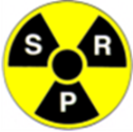
SRP Workshop on Ethical Dimensions of the Radiological Protection System June 2014 Further Reflections: The Ethics of Radiological Protection
Roger Coates
With thanks to Chris Clement (ICRP)

Slide 2
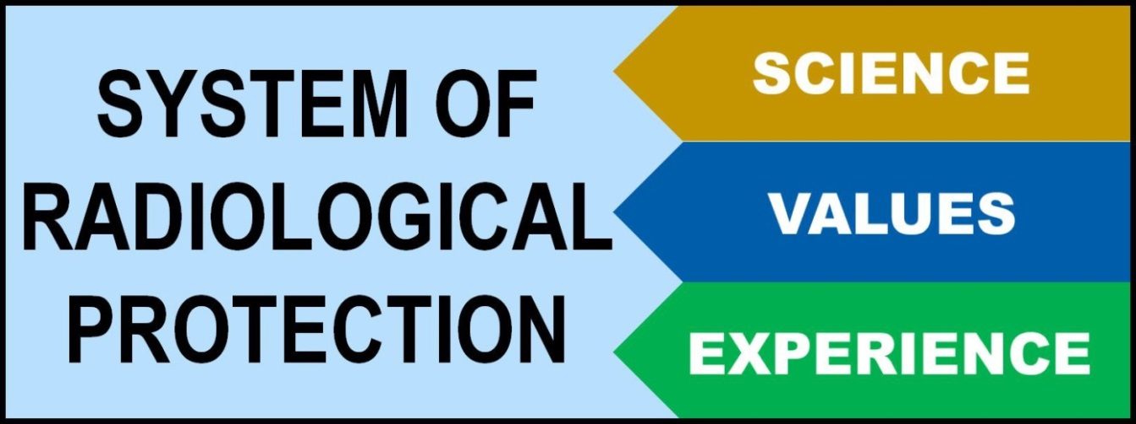
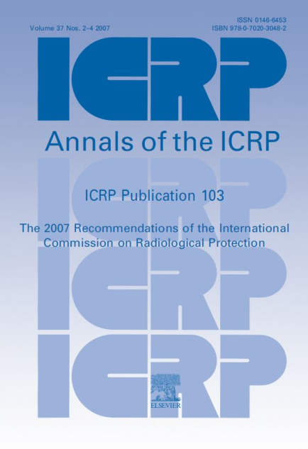
The System of Radiological Protection developed by ICRP is based on the latest science, social and ethical values, and nearly a century of experience

Slide 3
Fact and Value
Fact
What is
Questions of science
Descriptive statements
Value
What ought to be
Ethical questions
Normative statements

Slide 4
Background - Illustration
Although consistent with major Western and Eastern philosophical traditions, there is no clear and comprehensive description of the ethical basis of the system of radiological protection that can be applied globally.
Use of LNT is based on the virtue of prudence, but:
may lead to violations of the principles of respect for personal autonomy and dignity
may result in the imposition of a real risk of premature death to avert a potential risk.
e.g. Evacuation of elderly and ill persons from around Fukushima Daiichi appears to have violated a fundamental principle of medical practice: first, do no harm. However, if this population were not evacuated, would the right of caregivers to avoid an involuntary potential risk have been violated?

Slide 5
Moving from competing ethical schools of thought to a common set of values
So what is our principal challenge?

Slide 6
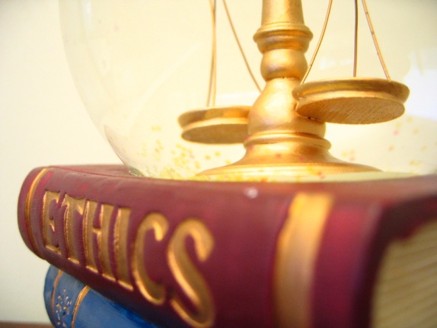
Ethics (Moral Philosophy)
The study of the moral value of human conduct
Normative Ethics: Figuring out what is right and wrong behaviour
VIRTUE
DUTY
CONSEQUENCE
Virtue
Ethics
Focus on habits of character of a person
Deontological Ethics
Actions are judged based on duty or obligation
Utilitarian
Ethics
Actions are judged by their consequences

Slide 7
Ethical Theories
CHARACTER
ACTIONS
THINGS
Virtue
Right
Good
Kant: actions are inherently right or wrong (deontology)
Aristotle: right actions are those that arise from virtuous character (virtue ethics)
Bentham: right actions are those that result in good outcomes (utilitarianism)

Slide 8
Value Judgements in Radiological Protection
Utilitarian Ethics
Actions are judged by their consequences
Justification
Do more good than harm
Optimisation
Maximize good vs. harm
Deontological Ethics
Actions are based on duty or obligation
Dose Limitation
No individual is unduly harmed
Dose Constraints aid optimization & increase equity

Slide 9
Elegant but Flawed
Utilitarianism
Consequence is central
Ignores justice
e.g. killing one person for the happiness for millions
Unknowable consequences
Calculating total utility (good) is as impossible as predicting the future
Deontology
Duty is central
Duty is not always clear
It does not always seem rational to ignore the consequences
Duties cannot all be categorical
In case of moral dilemma, relative stringency must be considered

Slide 10
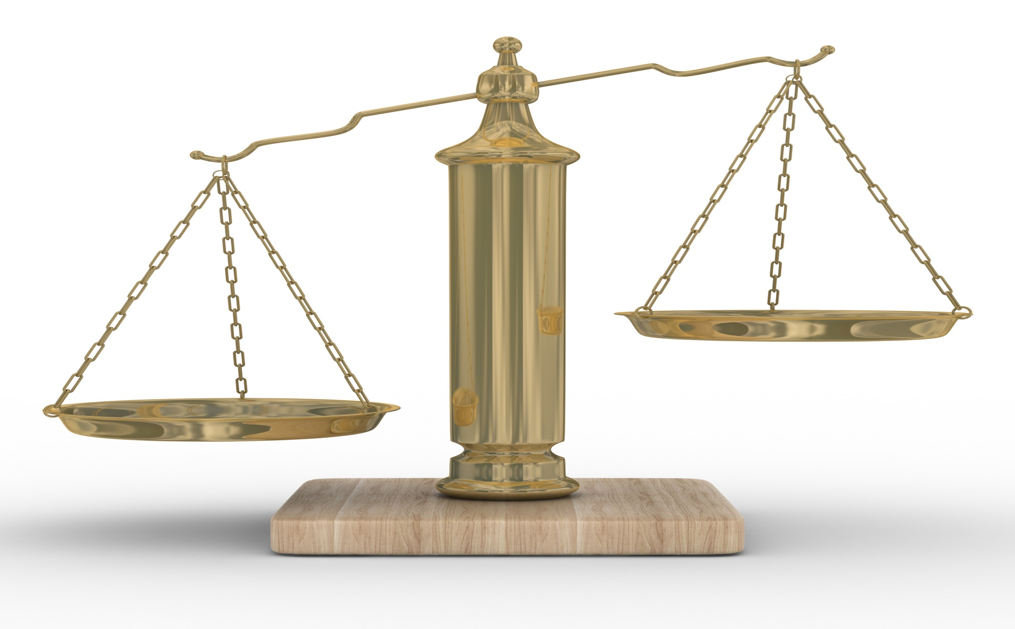
W.D. Ross: Balancing Obligations
What is right is a matter of balancing potentially conflicting responsibilities (values)

Slide 11
Values: A Pragmatic Way Forward
Seek a set of values:
Relevant to the system of radiological protection
Common (or at least acceptable) to the widest possible range of cultures today
International recommendations must be broadly applicable
That stand the test of being applied to current and foreseeable problems, with sensible results

Slide 12
Which Values?
Accountability
Accuracy
Adaptability
Benevolence
Candor
Charity
Clarity
Compassion
Competence
Confidence
Consistency
Correctness
Credibility
Decisiveness
Dignity
Effectiveness
Efficiency
Empathy
Environmental protection
Fairness
Fidelity
Gratitude
Harmonisation
Honesty
Human health
Individual autonomy
Individual benefit
Integrity
Justice
Knowledge
Leadership
Logic
Mercy
Meticulousness
Modesty
Non-maleficence
Open-mindedness
Partnership
Paternalism
Peace
Practicality
Pragmatism
Precaution
Promise-keeping
Promotion of aggregate good
Protection of animals
Protection of children
Protection of future generations
Privacy
Rationality
Reasonableness
Reparation
Responsibility
Human rights
Scientific correctness
Significance
Simplicity
Sincerity
Social benefit
Societal autonomy
Soundness
Stability
Timeliness
Tolerance
Trustworthiness
Truth
Understanding
Usefulness
Vision
Wisdom

Slide 13
Which Values?
Accountability
Accuracy
Adaptability
Benevolence
Candor
Charity
Clarity
Compassion
Competence
Confidence
Consistency
Correctness
Credibility
Decisiveness
Dignity
Effectiveness
Efficiency
Empathy
Environmental protection
Fairness
Fidelity
Gratitude
Harmonisation
Honesty
Human health
Individual autonomy
Individual benefit
Integrity
Justice
Knowledge
Leadership
Logic
Mercy
Meticulousness
Modesty
Non-maleficence
Open-mindedness
Partnership
Paternalism
Peace
Practicality
Pragmatism
Precaution
Promise-keeping
Promotion of aggregate good
Protection of animals
Protection of children
Protection of future generations
Privacy
Rationality
Reasonableness
Reparation
Responsibility
Human rights
Scientific correctness
Significance
Simplicity
Sincerity
Social benefit
Societal autonomy
Soundness
Stability
Timeliness
Tolerance
Trustworthiness
Truth
Understanding
Usefulness
Vision
Wisdom

Slide 14
Ross on Right: Balancing Fundamental Responsibilities (prima facie duties)
Fidelity
(keeping promises)
Reparation
(righting our wrongs)
Gratitude
(returning services to those from
whom we have accepted benefits)
Non-maleficence
(avoidance of the bad)
Promotion of aggregate good
(including justice and self-improvement)

Slide 15
Borrowed from: Senlin Liu / KunWoo Cho

Slide 16
Main Points: Daejeon (1)
(Public) Communication
Complexity of the system of radiological protection
Communicating radiological protection in simpler language
Failure of patriarchal top-down approach to risk communication
Need to address questions asked by the public
Public misunderstanding
Living in a “radiation free” world
Equating radiation with atomic bombs

Slide 17
Main Points: Daejeon (2)
Tolerability/Acceptability of risk
Failure of broad acceptance due to overemphasis of solely scientific approach
Primarily a question of ethics, informed by science
Well-being
For protection of people: consider well-being vs. “classical” health protection
People need to be protected from harm AND to feel “safe”

Slide 18
WHO Definition of Health
Health is a state of complete physical, mental and social well-being and not merely the absence of disease or infirmity
From the Preamble to the Constitution of the World Health Organization as adopted by the International Health Conference, New York, 19-22 June, 1946; signed on 22 July 1946 by the representatives of 61 States (Official Records of the World Health Organization, no. 2, p. 100) and entered into force on 7 April 1948.
The Definition has not been amended since 1948.

Slide 19
Objectives of Protection (for people)
?
Promotion of health* in relation to radiation exposures
*a state of complete physical, mental and social well-being and not merely the absence of disease or infirmity

Slide 20
Borrowed from: Jacques Lochard

Slide 21
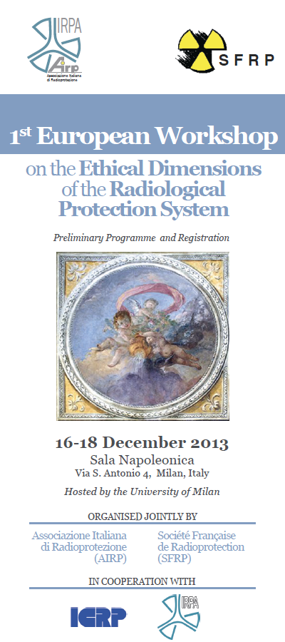
1st European Workshop
1st European Workshop on the Ethical Dimensions of the Radiological Protection System
2013 Dec 16-18, Milan, Italy
Organised jointly by the Associazione Italiana di Radioprotezione (AIRP), and Société Française de Radioprotection (SFRP)

Slide 22
Main Points: Milan
A set small of central values were identified
Focus on understanding and applying these values, rather than worrying too much about classical philosophical traditions
Use plain language and examples of practical application of these values to ensure a broad common understanding
ICRP is charged with development of the System of Radiological Protection, but it is essential to prepare the ethics publication cooperatively with the broader RP community

Slide 23
Milan (2)
Essential to have Values both within the System itself, but also in professional application:
“As professionals, we have the duty to put in place the right procedures and to behave according the spirit of the values”
Central Values:
Prudence
Dignity
Justice
Transparency
Benificence
Wellbeing

Slide 24
Milan (3)
Particular Challenges
Emergencies and Recovery
Dignity and Protection of Vulnerable Groups
Dose Limits
Hidden Ethical Judgements
Scientific Uncertainty
Prudence, but how much?
Other Key Issues
Must not consider RP in isolation
All RP Professionals have a duty to enhance public communication

Slide 25
The Objective
Clearer ethical framework
Professionals and the public better understand what the system is designed to achieve and why
(how is more a matter for professionals)
Solid basis, together with science and experience, for evolution of the system

Slide 26
And Finally ………….
As RP professionals we have a duty to ensure that our System of Protection is:
Fit for purpose
Appropriate and reasonable
Understandable
Over to You!

